Slide 1

A GENERATIVE APPROACH FOR FACIAL EXPRESSION DATA AUGMENTATION
Advanced Deep Learning Models and Methods
Azzoni Francesco
Fasana Corrado
Pasini Samuele

Slide 2
TABLE OF CONTENTS
Introduction
CycleGAN
Enhanced CycleGAN (ECycleGAN)
Conducted experiments
Conclusions

Slide 3


INTRODUCTION
Deep Learning (DL) approaches have been widely used in the last years to successfully solve several tasks.
However, these approaches are really data hungry, meaning that they require lots of data to be properly trained and obtain a satisfiable model.
DL architecture
Model

Slide 4
INTRODUCTION
What if data is limited?
Data augmentation techniques could be exploited to complement and complete the data manifold.
The augmented dataset is fed to the DL architecture for training.
DATA
AUGMENTATION
DL architecture
Model

Slide 5
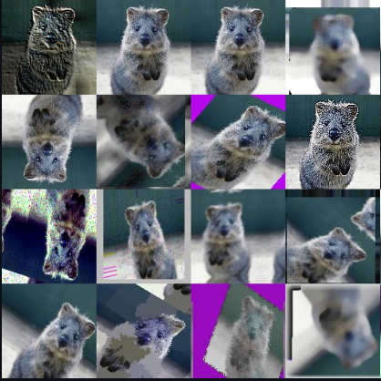
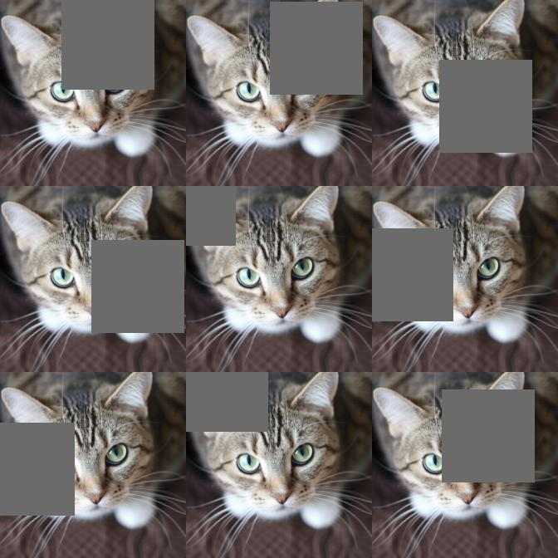
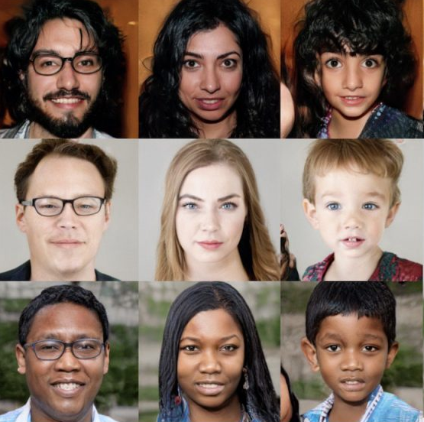
INTRODUCTION
Data augmentation
Image manipulation
Image erasing
Deep Generative models
https://github.com/aleju/imgaug
https://github.com/xkumiyu/numpy-data-augmentation
https://venturebeat.com/ai/gan-generative-adversarial-network-explainer-ai-machine-learning/

Slide 6
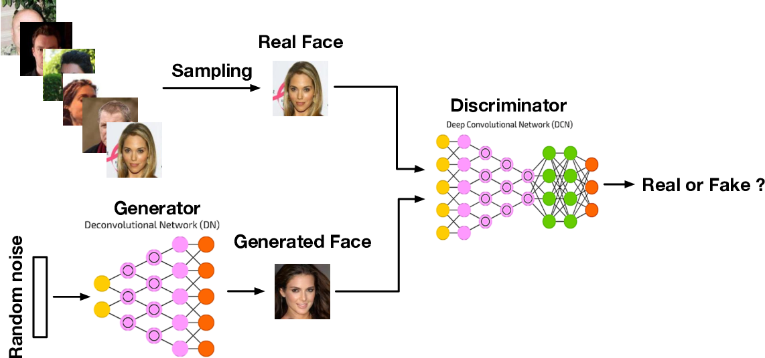
INTRODUCTION
Generative Adversarial Networks (GAN)
Wang, Z., She, Q., & Ward, T.E. (2019). Generative Adversarial Networks: A Survey and Taxonomy. ArXiv, abs/1906.01529.

Slide 7

INTRODUCTION
Image-to-Image Translation
Aims to transfer images from a source domain to a target one while preserving the content representations.
It can be performed exploiting GANs with the input being an image instead of random noise.
GAN-BASED
IMAGE-TO-IMAGE TRANSLATION
TRADITIONAL GAN
Random noise
Image of source domain
GAN
GAN
Generated image
Image of target domain
https://github.com/junyanz/pytorch-CycleGAN-and-pix2pix

Slide 8






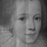









INTRODUCTION
Data augmentation for unbalanced datasets
Image-to-Image translation techniques can be exploited to generate samples of a poorly represented class starting from a well represented one.
FER2013 is an example of a dataset with such unbalance, the Disgust class has 547 samples while the Neutral class 6198.
FER2013
Disgust Augmented
Disgust
Neutral
Generated
Original
Image-to-Image
GAN

Slide 9
TABLE OF CONTENTS
Introduction
CycleGAN
Enhanced CycleGAN (ECycleGAN)
Conducted experiments
Conclusions

Slide 10
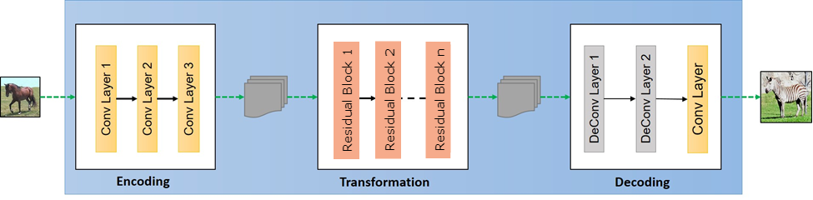
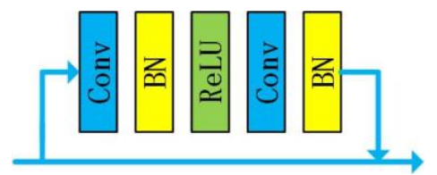
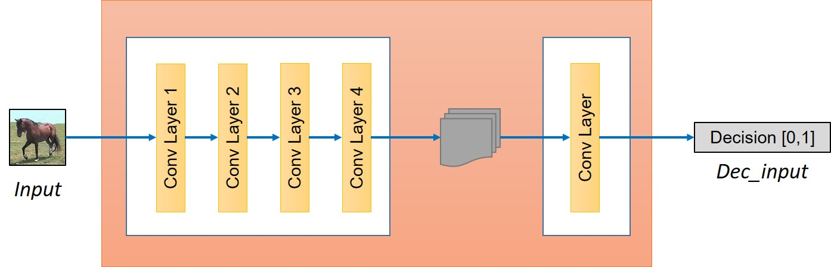
CycleGAN
[ZHU2017]
Generator Architecture
ResNet Residual Block
Discriminator Architecture
https://hardikbansal.github.io/CycleGANBlog/

Slide 11






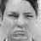




CycleGAN
Model Architecture
G(F(y))
D_{X}
fake x
G
F
Domain X
F(y)
sample y
real y
real x
Domain Y
sample x
G(x)
fake y
D_{Y}
F(G(x))

Slide 12



CycleGAN
Model Architecture
G(F(y))
D_{X}
fake x
G
F
Domain X
F(y)
sample y
real y
real x
Domain Y
sample x
G(x)
fake y
D_{Y}
F(G(x))

Slide 13

CycleGAN
Adversarial Loss
G(F(y))
D_{X}
fake x
G
F
Domain X
F(y)
sample y
real y
real x
Domain Y
sample x
G(x)
fake y
D_{Y}
F(G(x))
$$ℒ_{ℒ𝒮𝒢𝒜𝒩}\left(G,D_{Y},X,Y\right)=E_{y∼p_{data}\left(Y\right)}\left[{\left(D_{Y}\left(y\right)−1\right)}^{2}\right]+E_{x∼p_{data}\left(X\right)}\left[D_{Y}{\left(G\left(x\right)\right)}^{2}\right]$$

Slide 14
CycleGAN
Cycle consistency loss
G(F(y))
D_{X}
fake x
G
F
Domain X
F(y)
sample y
real y
real x
Domain Y
sample x
G(x)
fake y
D_{Y}
F(G(x))
$$ℒ_{𝓅𝒾𝓍ℯ𝓁−𝒸𝓎𝒸}\left(G,F\right)=E_{x∼P_{data}\left(X\right)}\left[{\left\|F\left(G\left(x\right)\right)−x\right\|}_{1}\right]+E_{y∼P_{data}\left(Y\right)}\left[{\left\|G\left(F\left(y\right)\right)−y\right\|}_{1}\right]$$
Notes:
Specificare che nel caso di CycleGAN é pixel-wise

Slide 15
CycleGAN
Identity Loss
G(y)
D_{X}
G
F
Domain X
sample y
real y
real x
Domain Y
sample x
D_{Y}
F(x)
$$ℒ_{𝓅𝒾𝓍ℯ𝓁−idt}\left(G,F\right)=E_{x∼P_{data}\left(X\right)}\left[{\left\|F\left(x\right)−x\right\|}_{1}\right]+E_{y∼P_{data}\left(Y\right)}\left[{\left\|G\left(y\right)−y\right\|}_{1}\right]$$

Slide 16
TABLE OF CONTENTS
Introduction
CycleGAN
Enhanced CycleGAN (ECycleGAN)
Conducted experiments
Conclusions

Slide 17
Enhanced CycleGAN
This architecture is based on that of CycleGAN, with the addition of a few modifications to improve the effectiveness of domain translation, trying to obtain more realistic images than the ones generated by CycleGAN.
CycleGAN
ECycleGAN
Generator architecture composed by residual blocks
Pixel-wise Cycle consistency loss
Least square adversarial loss (LSGAN)
Generator architecture composed by Residual Dense Normalization Blocks (RDNBs)
Perceptual Cycle consistency loss
Wasserstein adversarial loss with gradient penalty (WGAN-GP)

Slide 18
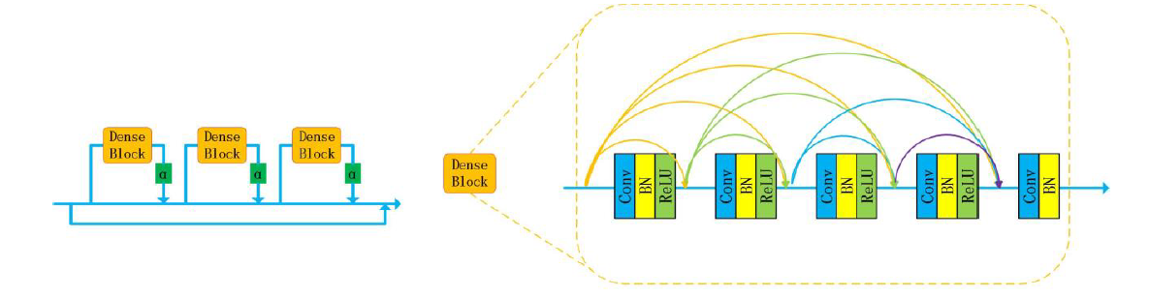
Enhanced CycleGAN
[ZHANG2020]
Generator Architecture
Residual Dense Normalization Block (RDNB)
Residual Resnet Block (CycleGAN)
https://hardikbansal.github.io/CycleGANBlog/

Slide 19
Enhanced CycleGAN
Cycle consistency Loss
ECycleGAN
CycleGAN
Original x
Reconstructed F(G(x))
Original x
Reconstructed F(G(x))
VGG19
VGG19
Pixel-wise Loss
Feature Loss
Perceptual Loss
Notes:
The same also for the identity loss, instead of F(G(X)) we will have F(X) …

Slide 20
TABLE OF CONTENTS
Introduction
CycleGAN
Enhanced CycleGAN (ECycleGAN)
Conducted experiments
Conclusions

Slide 21
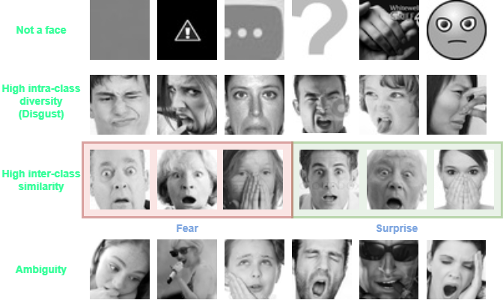
CONDUCTED EXPERIMENTS
FER2013 ANALYSIS

Slide 22
CONDUCTED EXPERIMENTS
SAMPLING STRATEGIES
[Zhu2018] assess the performances on CycleGAN for Facial Expression Data Augmentation on a subset of FER2013 dataset. However, the sampling method that is used is left unspecified.
For this reason, it was not possible to reach the performance reported in the paper even after using different sampling strategies.
Gaussian Likelihood
Confidence Filtering
Perform instance selection by removing those instances that lie in low-density regions of the data manifold.
First, a classifier is trained on the whole dataset. All the samples are then evaluated using the classifier and ranked according to the probability of belonging to their real class before selection.

Slide 23
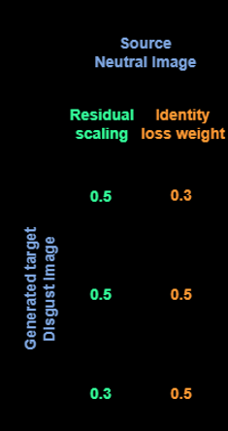
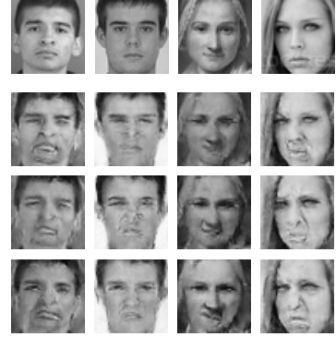
CONDUCTED EXPERIMENTS
CycleGAN experiments
Different experiments were performed changing the identity loss weight.
Given that the identity loss is pixel-wise, the generator does not learn to give more importance to disgusted features but instead it tries to output an image that is as close as possible to the input one.
For this reason, increasing the identity loss weight force CycleGAN to bring less changes to the faces.

Slide 24
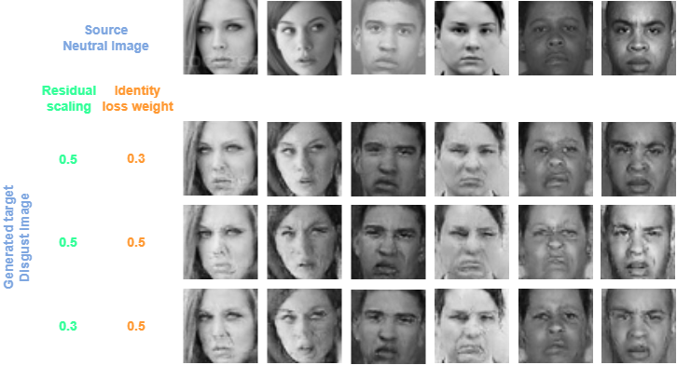
CONDUCTED EXPERIMENTS
ECycleGAN experiments
Increasing the identity loss weight force ECycleGAN to introduce more disgusted features, thanks to the use of the perceptual loss.

Slide 25
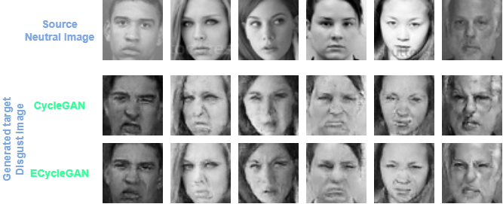
CONDUCTED EXPERIMENTS
ECycleGAN VS CycleGAN
Neutral-Disgust

Slide 26
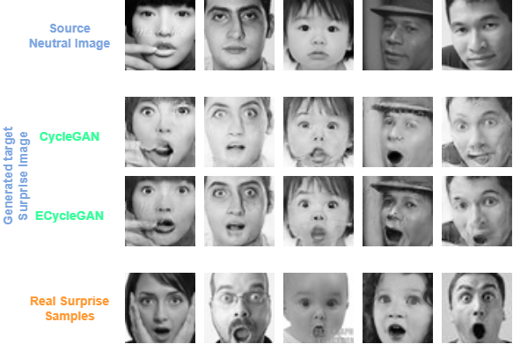
CONDUCTED EXPERIMENTS
ECycleGAN VS CycleGAN
Neutral-Surprise

Slide 27
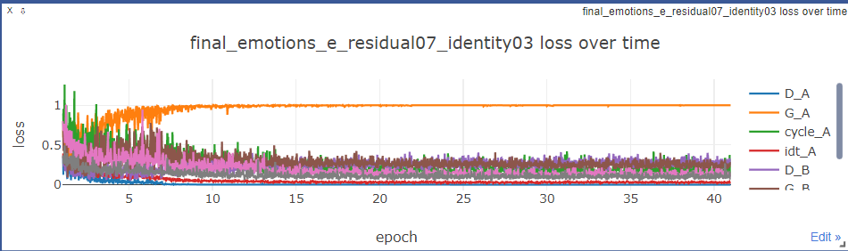
CONDUCTED EXPERIMENTS
LOSS TREND ANALYSIS WITH FEW SAMPLES
A → Neutral domain
B → Disgust domain
G → Generator that transform images from A to B
D_{A} → Discriminator of images belonging to domain B
$$ℒ_{G_A}=E_{x∼p_{data}\left(A\right)}\left[{\left(D_{A}\left(G(x)\right)−1\right)}^{2}\right]$$
$$ℒ_{D_A}=E_{y∼p_{data}\left(B\right)}\left[{\left(D_{A}\left(y\right)−1\right)}^{2}\right]+E_{x∼p_{data}\left(A\right)}\left[D_{A}{\left(G\left(x\right)\right)}^{2}\right]$$

Slide 28
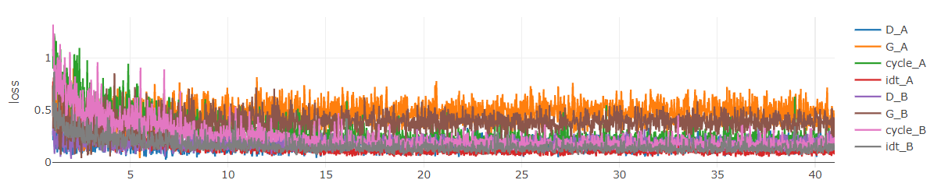
CONDUCTED EXPERIMENTS
LOSS TREND ANALYSIS WITH MORE SAMPLES
A → Neutral domain
B → Surprise domain
G → Generator that transform images from A to B
D_{A} → Discriminator of images belonging to domain B
$$ℒ_{G_A}=E_{x∼p_{data}\left(A\right)}\left[{\left(D_{A}\left(G(x)\right)−1\right)}^{2}\right]$$
$$ℒ_{D_A}=E_{y∼p_{data}\left(B\right)}\left[{\left(D_{A}\left(y\right)−1\right)}^{2}\right]+E_{x∼p_{data}\left(A\right)}\left[D_{A}{\left(G\left(x\right)\right)}^{2}\right]$$

Slide 29
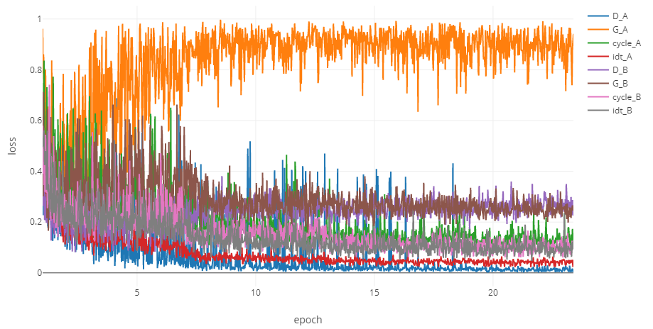
CONDUCTED EXPERIMENTS
OVERFITTING MITIGATION
One-sided Label smoothing
It is concerned with the addition of label noise.
The discriminator is trained on randomly flipped labels instead of real labels. This label noise is applied only to the samples of the less represented class when fed to the discriminator.
Notes:
Real sample becomes fake

Slide 30
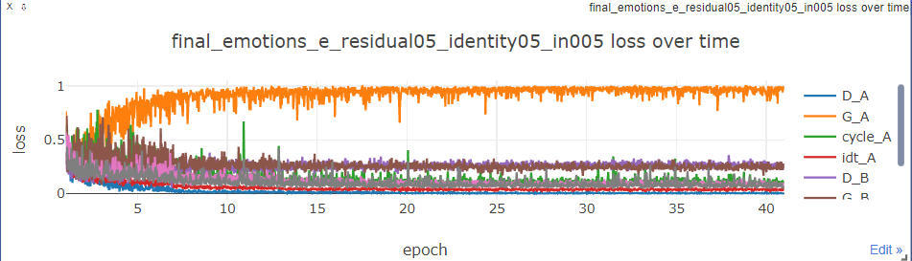
CONDUCTED EXPERIMENTS
OVERFITTING MITIGATION
Instance Noise
The discriminator sees the correct labels, but its input sample is noisy.
The considered noise is a
Gaussian one with zero mean and standard deviation
decaying during training.

Slide 31
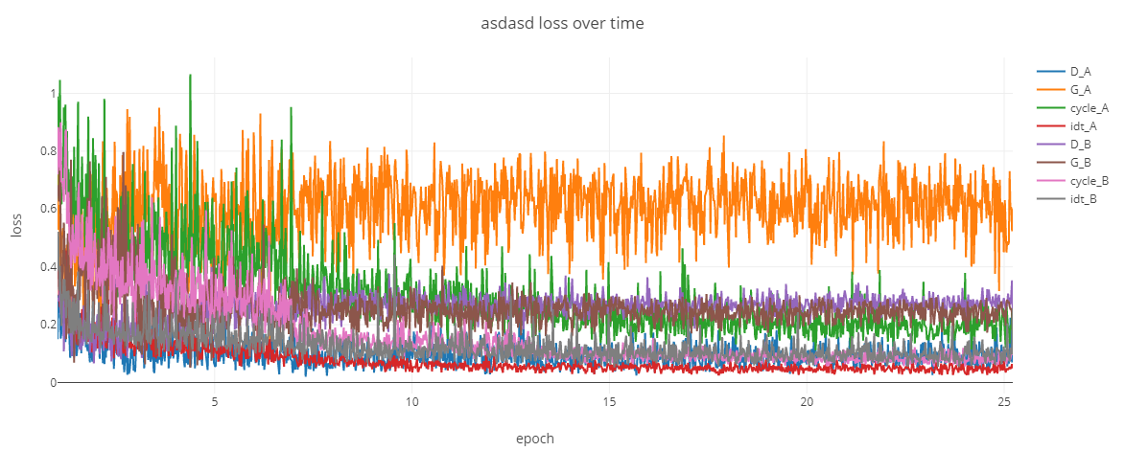
CONDUCTED EXPERIMENTS
OVERFITTING MITIGATION
Alternate training
When the training procedure is initiated (after a fixed number of epochs) the discriminator of the less represented class is not trained at every iteration.

Slide 32
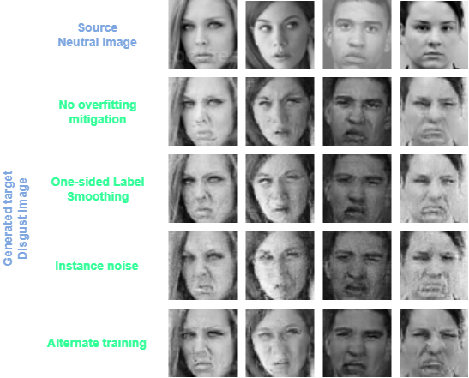
CONDUCTED EXPERIMENTS
OVERFITTING MITIGATION RESULTS

Slide 33
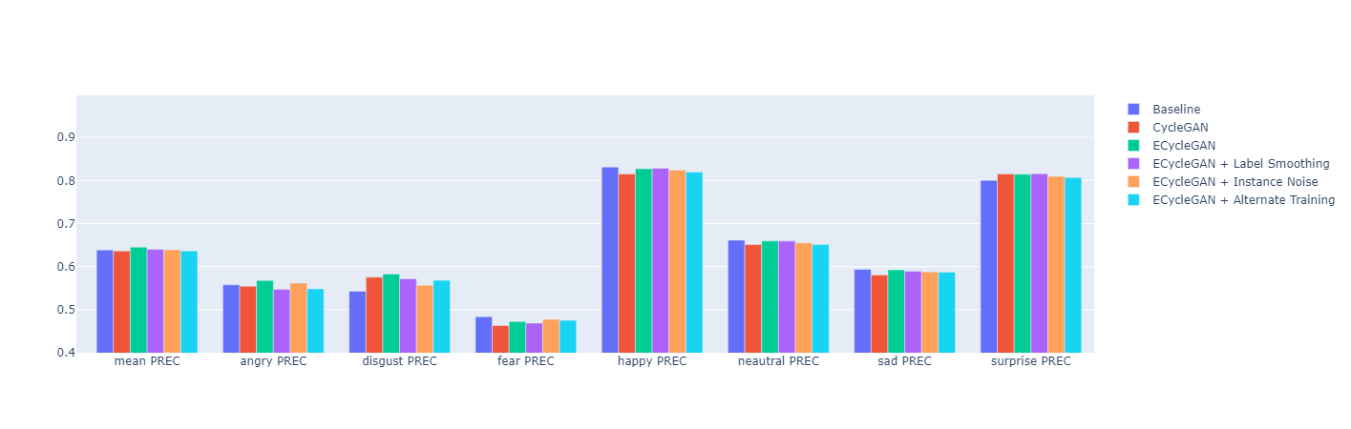
CONDUCTED EXPERIMENTS
CLASSIFICATION RESULTS
All experiments (apart from Baseline) are performed with an augmentation of 100 Disgust samples.

Slide 34
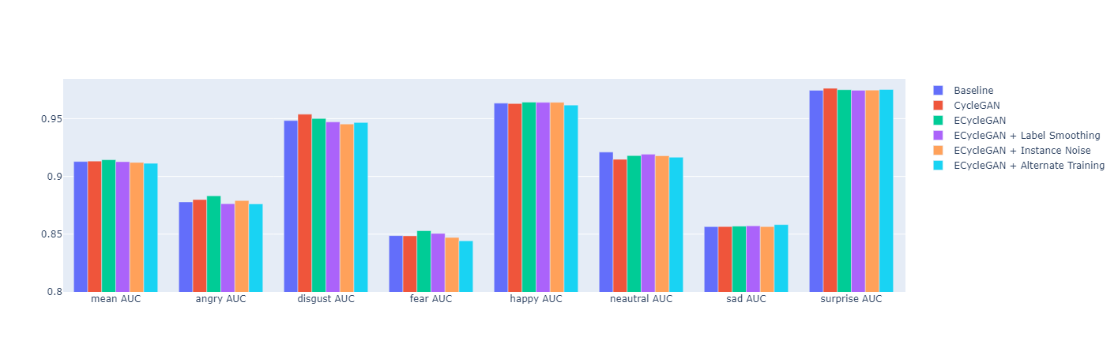
CONDUCTED EXPERIMENTS
CLASSIFICATION RESULTS
All experiments (apart from Baseline) are performed with an augmentation of 100 Disgust samples.

Slide 35
TABLE OF CONTENTS
Introduction
CycleGAN
Enhanced CycleGAN (ECycleGAN)
Conducted experiments
Conclusions

Slide 36
CONCLUSIONS
RESULTS DISCUSSION
The experiments report partial effectiveness of the proposed generative approach for Facial Expression Data Augmentation.
Despite an acceptable qualitative result on some samples, the influence of bad generated samples is too high to augment the dataset significantly.
Introducing more samples (from 200 on), the major influence of the bad-quality ones results in a degradation of the classification performances.
FUTURE WORK
Adopt the complete ECycleGAN architecture and perform a finer hyper-parameter tuning if resources are available.
Apply other filtering methods to the input dataset.
Perform instance selection to choose the best samples generated by ECycleGANs.
Explore other techniques to avoid overfitting the discriminator.
Pretrain the VGG19 network used for the perceptual loss with a pretext task on human faces to extract more suitable features.

Slide 37
CONCLUSIONS
References
[Zhu2017]: Zhu et al., Unpaired Image-to-Image Translation using Cycle-Consistent Adversarial Networks
[Zhu2018]: Zhu et al., Emotion Classification with Data Augmentation Using Generative Adversarial Networks
[Zhang2020]: Zhang and Zhou, ECycleGAN: Enhanced Cycle-Consistent Generative Adversarial Networks

Slide 38
THANKS FOR THE ATTENTION
Azzoni Francesco
Fasana Corrado
Pasini Samuele

